Slide 1


i™ OPEN PIPELINE
Commercial Production Model + Founding Partner Pilot
Open architecture. Human-governed intelligence. Optional industry adapters. Evidence-gated hardware.
iOpen™
KRDID™
JUST ASK BUDDY™
STRMKRD — Technology should serve humanity.

Slide 2
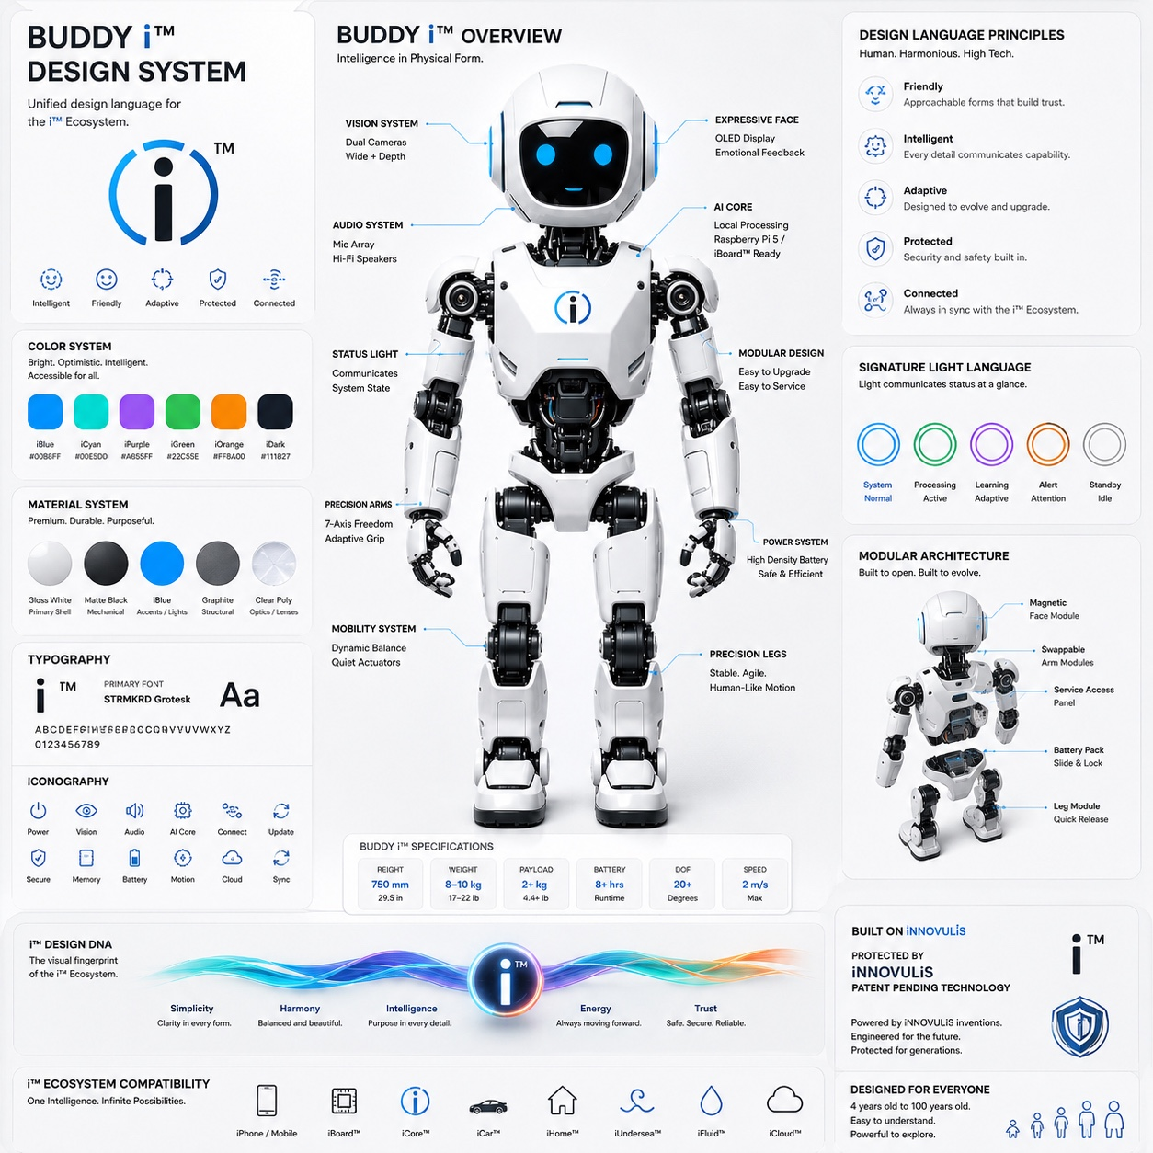
Buddy i™ Design System
Unified design language for the physical and digital i™ ecosystem.
Source: user-provided Buddy i™ design system artwork. Product specifications shown in artwork are treated as design targets unless independently measured.

Slide 3
The Pipe Is Open
i™ works natively. PCIe, CXL, UEC and vendor ecosystems are compatibility adapters—not prerequisites.
KRDID™
→
iSupervisor™
→
iMatrix™
→
iBit / iMod
→
Hardware Contract
Pure i™
Existing Hardware
Industry Compatibility
Download the spec and software. Build a custom board, FPGA or ASIC endpoint. Implement the board profile and conformance contract.
Use SBCs, accelerators, commercial FPGA boards or local PCs through replaceable adapters.
Add PCIe/CXL/UEC/Ethernet adapters when interoperability with established ecosystems is desired.
Invariant
No external standards body, vendor ID, bus, cloud, board vendor, or proprietary toolchain is required to define i™ identity.

Slide 4
Production Architecture
One identity and governance plane; multiple execution and transport adapters.
Buddy™ / ARTIFACTGPTm™
Human interface + commercial product surface
OPTIONAL ADAPTERS
KRDID™ / iAnchor™
Canonical identity, provenance, lineage
PCIe / PCI-SIG
CXL 4.0
iSupervisor™ / iConstitution™
Governance, authorization, evidence gates
UEC / UET
iMatrix™ / iMoE™ / iVRAM™
Routing, expert selection, sparse memory windows
Ethernet / RDMA
Cloud / Vendor APIs
iKernel™ / iMmAdapteri™ / iElway™
Execution, zero-copy references, telemetry
Remove any adapter → i™ core remains.

Slide 5
Evidence Before Activation
Commercial partners get explicit PASS / HOLD / FAIL gates. Software proof never becomes physical proof by wording.
Architecture + ABI
PASS
Reference math, 64-byte contracts, ioctl geometry
Go runtime / race safety
PASS
iVRAM ring, eventfd/epoll, stale rejection
Generic PCI MSI-X discovery
PASS_REFERENCE
Capability decoding + table geometry
Real PCI device / BAR
HOLD
Requires target hardware discovery
DMA registration
HOLD
Requires IOMMU/device-visible mapping
Real MSI-X completion
HOLD
Requires observed IRQ + completion receipt
Physical state 0x01
HOLD
Only after all measured gates + authorized release

Slide 6
Commercial Model
Open understanding; paid implementation, support, production rights and enterprise integration.
iOpen™
iLearn™
iBuilder™
$0
Public architecture, protocols, test vectors
$0 edu / $9 mo
Students, teachers, researchers, learning labs
$39 mo
Private projects, advanced tools, local receipts
iTeam™
iFabric Commercial™
iMod Production™
$249 mo
5 seats, shared registries, CI conformance
$1,500 mo
Commercial SDK + up to 100 software endpoints
$50k yr + royalty
RTL/driver integration + redistribution rights
Enterprise physical implementation: custom NRE + negotiated royalty, based on actual licensed IP and support scope.

Slide 7
Founding Partner Economics
Low-friction pilot, then production economics that scale with partner success.
90-Day Pilot
Production Platform
Standard Royalty
Enhanced Physical IP
Included Pilot Nodes
$12,500
$50,000
1.5%
2.5%
10
100% credit toward Year 1
annual base license
Net Licensed Product Revenue
when private implementation IP is licensed
prototype nodes
Pricing principle
Standards overhead
The public pipe stays open. Revenue comes from private implementation IP, commercial production rights, engineering support, conformance, and enterprise integration—not permission to learn.
PCI-SIG membership is optional for native i™ operation. A partner that wants official PCI ecosystem identity can obtain membership/VID as an adapter credential.
PCI-SIG: $5,000 annual membership; Vendor ID assignment listed as a membership benefit. Source: pcisig.com/membership/become-member and pcisig.com/faq.

Slide 8
Partner Onboarding
A repeatable path from downloaded specification to measured hardware evidence.
1
Ingest Profile
→
2
Compile iMod
→
3
Conformance Gate
→
4
Physical Activation
Board/device identity, resources, physical constraints
Native builder, board-specific adapter, no fake pins/addresses
Auth, replay rejection, namespace, memory bounds, receipts
Measured BAR/DMA/IRQ/readback + explicit authorized release
Release invariant
No physical promotion without identity + resource validation + measured readback + IRQ/DMA evidence + explicit authorized release.
This protects partners from “green dashboards” that merely restate configuration files.

Slide 9
Industry Standards as Adapters
i™ can interoperate with familiar industry ecosystems without allowing them to define i™ identity.
PCI-SIG / PCIe
CXL 4.0
Ultra Ethernet
Optional production interoperability. Membership currently lists a $5,000 annual fee and Vendor ID assignment benefit. Native i™ operation does not depend on it.
Optional coherent memory/accelerator adapter. CXL 4.0 publicly states 128 GT/s and bundled-port support.
Optional fabric transport. Ultra Ethernet Consortium lists v1.0.3 (July 16, 2026) as the current public specification.
KRDID™ remains canonical
External Vendor IDs, CXL device identities, network addresses and other standards identifiers are bound as verified adapter metadata.
Sources: pcisig.com/membership/become-member; computeexpresslink.org/about-cxl; ultraethernet.org/specification-history.

Slide 10
If i™ Enters Payments
Treat payment functionality as a separate regulated product scope—not as an automatic property of the architecture.
PCI DSS
PTS POI
Secure Software
PCI SSC currently lists PCI DSS v4.0.1. Scope depends on the actual cardholder-data environment and role.
PCI SSC currently lists PTS POI Modular Security Requirements v7.0 for devices protecting PINs/account data.
Payment software should be independently scoped against applicable PCI software and payment-brand/acquirer requirements.
Commercial rule
No product is marketed as PCI DSS / PTS / EMV / CXL / PCI-SIG certified unless that specific implementation has actually earned that evidence.
Sources: pcisecuritystandards.org Document Library and PTS POI standard page. Compliance scope must be determined for the actual product/environment.

Slide 11
Master IP License — First Partner Pilot
A pilot agreement that protects both openness and proprietary implementation IP.
Open stays open
Pilot is evaluation
Publicly licensed specifications remain under their public license.
90 days, 10 prototype nodes, no mass manufacture or production representation.
Production is separate
Evidence language
Production Addendum defines field of use, products, royalties, certification and redistribution.
BUILT / VERIFIED / DEPLOYED / MEASURED / PROVEN remain separate.
Third-party rights
No fake certification
PCI-SIG, CXL, foundry/PDK and standards rights remain separately obtained when required.
No implied PCI/CXL/PCI DSS/PTS/FCC/CE/UL certification.

Slide 12
BUILD ON i™
Free to learn. Open to build. Commercial when you ship.
Founding Partner Pilot
$12,500 • 90 days • 10 prototype nodes • 40 engineering hours • private conformance • 100% credit toward Year 1
JUST ASK BUDDY™
Technology should serve humanity.
i™ • ARTIFACTGPTm™ • KRDID™ • iMod™ • iVRAM™

Slide 13
Current External Reference Points
Official sources used only for current standards/compliance facts. i™ architecture and commercial terms are internal design choices.
PCI-SIG membership + VID
https://pcisig.com/membership/become-member
Annual membership $5,000; Vendor ID assignment listed as a member benefit.
PCI-SIG FAQ
https://pcisig.com/faq
Vendor ID assignments are given upon joining PCI-SIG.
CXL 4.0
https://computeexpresslink.org/about-cxl/
CXL 4.0: 128 GT/s, bundled ports, memory RAS enhancements.
Ultra Ethernet
https://ultraethernet.org/specification-history/
v1.0.3 listed as current public spec, July 16, 2026.
PCI Security Standards
https://www.pcisecuritystandards.org/document_library/
PCI DSS v4.0.1 and PTS POI v7.0 are listed in the current document library.
Note: Standards membership, certification and compliance are optional/implementation-specific adapters unless the target product or market requires them.

